Slide 1
Generics
Generic mechanism is an important goal of object-oriented programming that supports reusability.
For example: implementation to sort an array of items, where logic is independent of the object type being sorted.
Prior to Java 5, generic objects are implemented by using casting before using object method as generic implementation isn’t supported.
In 2004, Java 5 was released and provided support for generic methods and classes.

Slide 2
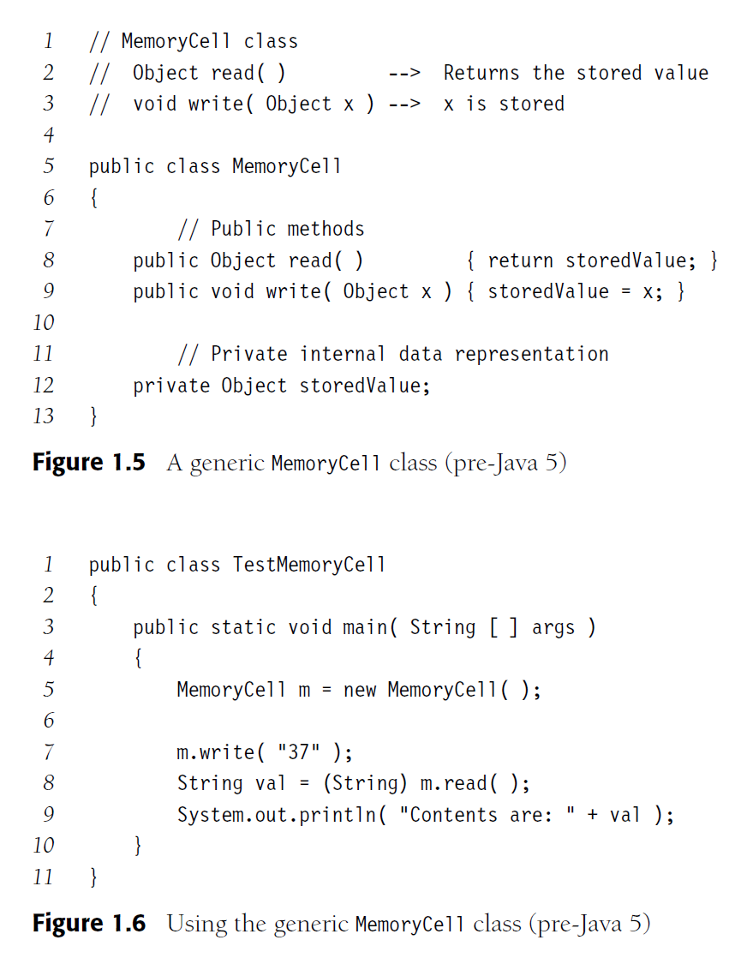
Generic Class (Pre-Java 5)

Slide 3
What is Java Generics?
Generics is the capability to parameterize types. With this capability, you can define a class or a method with generic types that can be substituted using concrete types by the compiler.
Public class MemoryCell<T>
For example, from this generic class MemoryCell<T>, you may create a MemoryCell object for holding strings and a MemoryCell object for holding numbers. Here, strings and numbers are concrete types that replace the generic type.
MemoryCell<Integer> n = new MemoryCell<Integer> ( );
MemoryCell<String> s = new MemoryCell<String> ( );

Slide 4
Implementing generics
// a parameterized (generic) class
public class name<Type> {
or
public class name<Type, Type, ..., Type> {
By putting the Type in < >, you are demanding that any client that constructs your object must supply a type parameter.
You can require multiple type parameters separated by commas.
The rest of your class's code can refer to that type by name.
The convention is to use a 1-letter name such as:
T for Type, E for Element, N for Number, K for Key, or V for Value. (eg. Hashmap<K,V>)
The type parameter is instantiated by the client. (e.g. E → String)

Slide 5
Example of Type Parameters
List<Type> name = new ArrayList<Type>();
We say that the ArrayList class accepts a type parameter, or that it is a generic class.
List<String> names = new ArrayList<String>();
List<Double> names = new ArrayList<Double>();
List<Integer> names = new ArrayList<Integer>();
List<Class> names = new ArrayList<Class>();

Slide 6
Why Generics?
The key benefit of generics is to enable errors to be detected at compile time rather than at runtime.
If you attempt to use the class or method with an incompatible object, a compile error occurs.
A generic class or method permits you to specify allowable types of objects that the class or method may work with while often avoiding the need for explicit casts.

Slide 7
Generic Type
Generic Instantiation
Runtime error
Improves reliability
Compile error

Slide 8
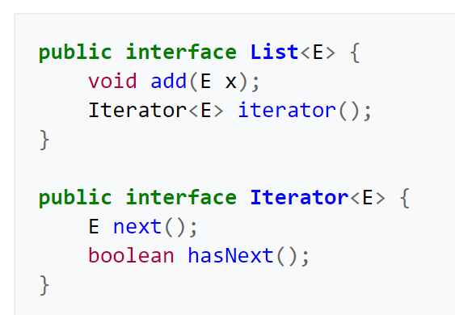
Summary - Why Generics?
Strong type checking or type safety at compile time
Avoid ClassCastException
Eliminates explicit casting, which is necessary prior to Java 5
Allows to design generic algorithms
List list = new ArrayList();
list.add("test"); // A String that cannot be cast to an Integer
Integer i = (Integer)list.get(0); // Run time error
List <String> list = new ArrayList<String>();
list.add("test");
Integer i = list.get(0);// compiling error

Slide 9
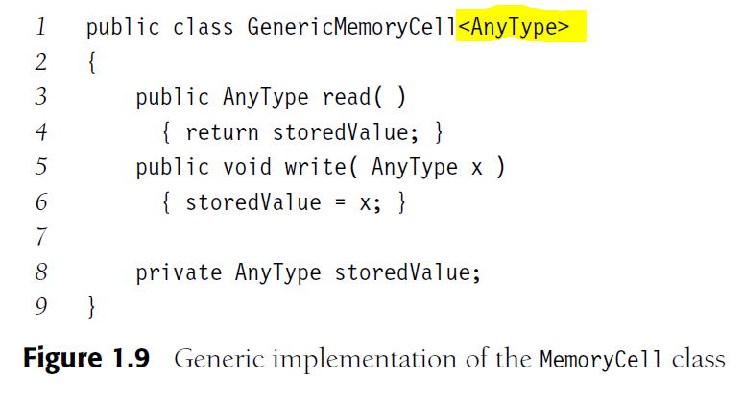
Generic Class (Java 5)
//Declaration and Instantiation using Java generics
GenericMemoryCell<String> s = new GenericMemoryCell<String> ( );
s.write(“test”)
String input = s.read(); //No Explicit casting
GenericMemoryCell<Integer> n = new GenericMemoryCell<Integer> ( );
n.write(124)
int input = n.read(); //No Explicit casting (Integer auto-unbox to int)

Slide 10
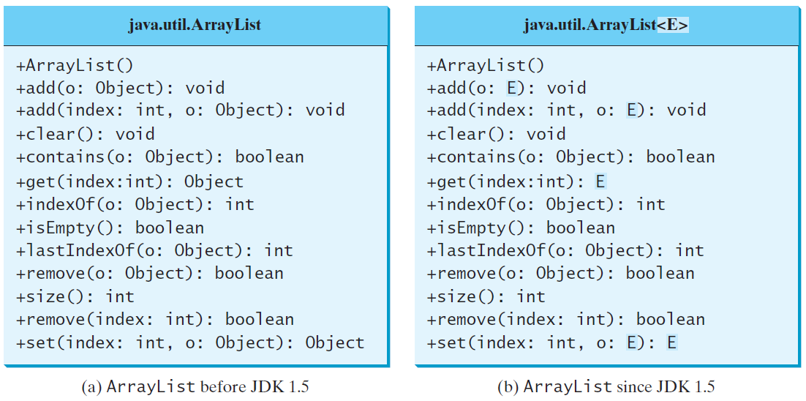
Generic ArrayList in JDK 1.5

Slide 11
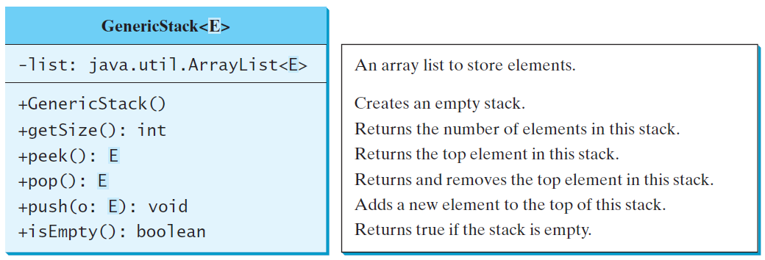
Declaring Generic Classes and Interfaces

Slide 12
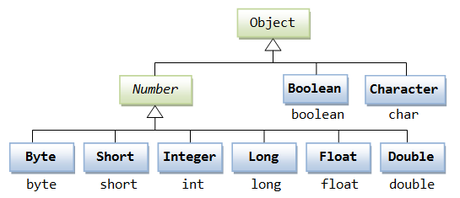
Generic Methods
public static <E> void print(E[] list) {
for (int i = 0; i < list.length; i++)
System.out.print(list[i] + " ");
System.out.println();
}
public static void print(Object[] list) {
for (int i = 0; i < list.length; i++)
System.out.print(list[i] + " ");
System.out.println();
}
https://www3.ntu.edu.sg/home/ehchua/programming/java/JavaGeneric.html

Slide 13
Bounded Type parameters
<Type extends SuperType>
An upper bound; accepts the given supertype or any of its subtypes.
Works for multiple superclass/interfaces with & :
<Type extends ClassA & InterfaceB & InterfaceC & ...>
<Type super SuperType>
A lower bound; accepts the given supertype or any of its supertypes
extends is used in a general sense to mean either “extends”
(as in classes) or "implements" (as in interfaces).

Slide 14
Bounded Generic Type
public static <T> int countGreaterThan(T[] anArray, T elem) {
int count = 0;
for (T e : anArray)
if (e > elem)// compiler error (>) applies only to primitive types (int, double,char) & can’t use the > operator to compare objects.
++count;
return count;
}
public interface Comparable<T> {
public int compareTo(T o);
}
public static <T extends Comparable<T>> int countGreaterThan(T[] anArray, T elem) {
int count = 0;
for (T e : anArray)
if (e.compareTo(elem) > 0)
++count;
return count;
}

Slide 15
Bounded Generic Type
public static void main(String[] args ) {
Rectangle rectangle = new Rectangle(2, 2);
Circle circle = new Circle (2);
System.out.println("Same area? " + equalArea(rectangle, circle));
}
public static <E extends GeometricObject> boolean
equalArea(E object1, E object2) {
return object1.getArea() == object2.getArea();
}
Accepts GeometricObject or its subclasses
Eg. Number class or its subclasses

Slide 16
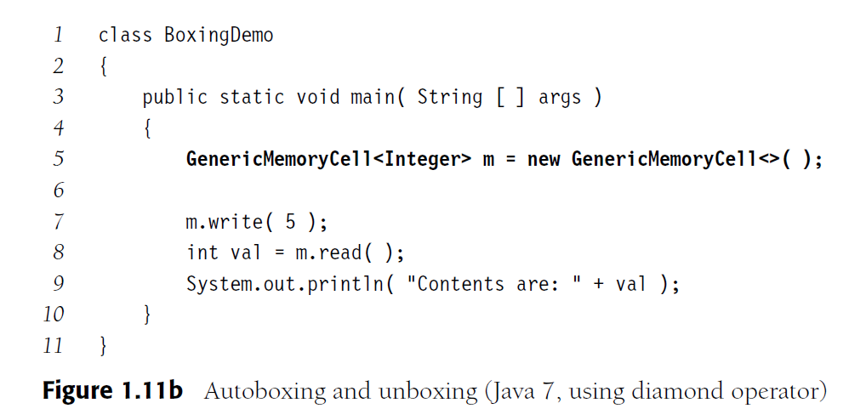
Autoboxing and Diamond Operator

Slide 17
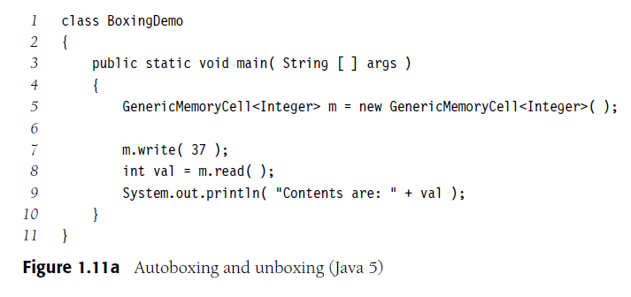
Autoboxing No Casting Needed
And if an Integer is passed in a place where an int is required, the compiler will insert a call to the intValue method behind the scenes.
ArrayList<Double> list = new ArrayList<>();
list.add(5.5); // double auto-box to new Double(5.5)
list.add(3.0); // 3.0 is automatically converted to new Double(3.0)
Double doubleObject = list.get(0); // No casting is needed
double d = list.get(1); // Auto-unboxed to double

Slide 18
The Diamond Operator
In Java 7, the declaration:
GenericMemoryCell<String> m =
new GenericMemoryCell<String> ( );
can be written as:
GenericMemoryCell<String> m =
new GenericMemoryCell< > ( ); // type inference

Slide 19
Compatibility of Array Types
If a Person class has a subclass of Employee, then it is possible to write:
Person x = new Employee();
In terms of array, we can write as follows:
Person x[] = new Employee[5];
Arrays in Java are “covariant” or type-compatiable, so the above assignment works.
Each array keeps track of the type of object is allowed, otherwise ArrayStoreException will occur

Slide 20
Array Types
Now consider this code if both Employee and Student are subclasses of Person:
Person[] arr = new Employee[5];
arr[0] = new Student();
The compiler doesn’t catch this since arr’s type is Person and Student is a Person.
But at runtime, this is an error since Student is not an Employee.

Slide 21
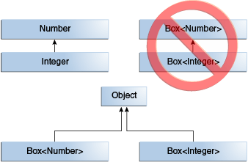
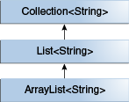
Generics is not covariant
Java Generics with a specific type T, do not support covariant or contravariant substitutions. That's because to avoid the situation like ArrayStoreException which we saw in the case of arrays.
https://docs.oracle.com/javase/tutorial/java/generics/inheritance.html

Slide 22


Wildcards
Why wildcards are necessary? To achieve true generics and covariance
GeometricObject
Number
List<GeometricObject>
List<Number>
Rectangle
Integer
List<Rectangle>
List<Integer>
GeometricObject obj1 = new GeometricObject()
Rectangle obj2 = new Rectangle()
obj1 = obj2;
List<GeometricObject> obj1 = new List<GeometericObject>();
List<Rectangle> obj2 = new List<Rectangle>();
obj1 = obj2;
Number num1 = new Integer()
Above statement allowed based on inheritance (super and subclass )

Slide 23
Wildcards
?: known as wildcard
Java5: wildcards are used to express subclasses (or superclasses) of parameter types
List<?> list
List<Integers> or List<Double> // anything
Difference between List<?> and List<Number> :
? can become any particular type; Number is just one such type.
List<Number> is restrictive; wouldn't take a List<Integer>
As Integer is subtype of Number, but List<Number> is not a subtype of List<Number>

Slide 24
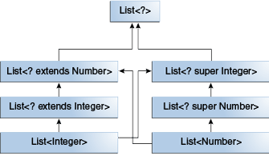
Wildcards
Why wildcards are necessary? To achieve true generics and covariance
? unbounded wildcard
List<?> listUknown = new ArrayList<A>();
? extends T upper bounded wildcard
List<? extends A> listUknown = new ArrayList<A>();
? super T lower bound wildcard
List<? super A> listUknown = new ArrayList<A>();

Slide 25
Example of using ?
The sumOfList method returns the sum of the numbers in a list:
public static double sumOfList(List<? extends Number> list)
{
double s = 0.0;
for (Number n : list)
s += n.doubleValue();
return s;
}
List<Integer> li = Arrays.asList(1, 2, 3);
System.out.println("sum = " + sumOfList(li));
List<Double> ld = Arrays.asList(1.2, 2.3, 3.5);
System.out.println("sum = " + sumOfList(ld));

Slide 26
Wildcards
List<Integer> integers = new ArrayList<>();
List<Number> numbers = new ArrayList<>();
numbers = integers; // incompatible types: java.util.List<java.lang.Integer> cannot be converted to java.util.List<java.lang.Number>
List<Integer> integers = new ArrayList<>();
integers.add(1);
List<? extends Number> numbers = integers;
System.out.println(numbers);

Slide 27
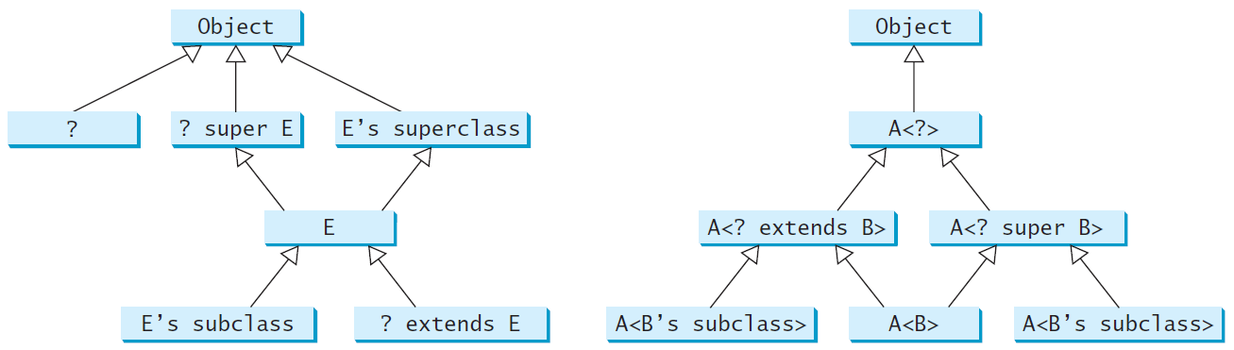
Generic Types and Wildcard Types

Slide 28
Erasure and Restrictions on Generics
Generics are implemented using an approach called type erasure. The compiler uses the generic type information to compile the code, but erases it afterwards. So the generic information is not available at run time.
All generics types become type Object once compiled.
One reason: Backward compatibility with old byte code.
At runtime, all generic instantiations have the same type.

Slide 29
Compile Time Checking
For example, the compiler checks whether generics is used correctly for the following code in (a) and translates it into the equivalent code in (b) for runtime use. The code in (b) uses the raw type.

Slide 30
Restrictions on Generics
Restriction 1: Cannot Create an Instance of a Generic Type. (i.e., new E()).
Restriction 2: Generic Array Creation is Not Allowed. (i.e., new E[100]).
Restriction 3: A Generic Type Parameter of a Class Is Not Allowed in a Static Context.
Restriction 4: Exception Classes Cannot be Generic.

